Slide 1
KILIMO TEXT
digitize your farm

Slide 2
KEY PROBLEM
Current most of agricultural activities are being conducted locally where much of energy and time is consumed during these activities thus leading to low overall yield to the farmers

Slide 3
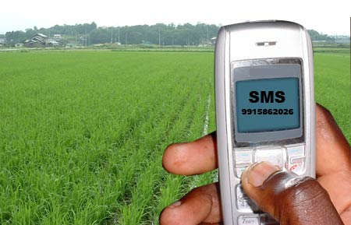
SOLUTION
The above challenge can be solved by our system that allow the farmers to control conditions of the farm automatically using sms
With our system farmers will be able to determine conditions including moisture content and soil PH
control automatic spraying and irrigation

Slide 4
OUR TEAM (Digital Farmers)
Wilbroad Nyirenda
Vaileth Mtei
Mohamed Musa
Kalebu Gwalugano
Denis Ahadi
Kulwa Maro
Beatrice Mike
Mashauri Kelvin

Slide 5
Our project Milestone
Designing The Electrical and Mechanical Mechanism
Creating a Functioning prototype
Performing crowdfunding on Kickstarter and Indiegogo for Our project
Creating Minimum viable product ready to be used by Farmers
Promoting our system on various advertisement platform
Earning of our revenue through installation our system to farmers
Scaling up of production to reach more farmers

Slide 6
How it works ?
SMS GATEWAY
FARMER MOBILE
CONTROLLER
SENSORS
ACTUATORS
MACRONUTRIENT SENSOR
MOISTURE SENSOR
WATER PUMP
SPRAY MECHANISM

Slide 7
TECHNOLOGY
We are going to use sms technology integrated with Artificial intelligence(Natural language processing to ensure control and management of the farm is more convenient

